Slide 1
Course Introduction
AI ToolKit
Fall Semester, 2023

Slide 2
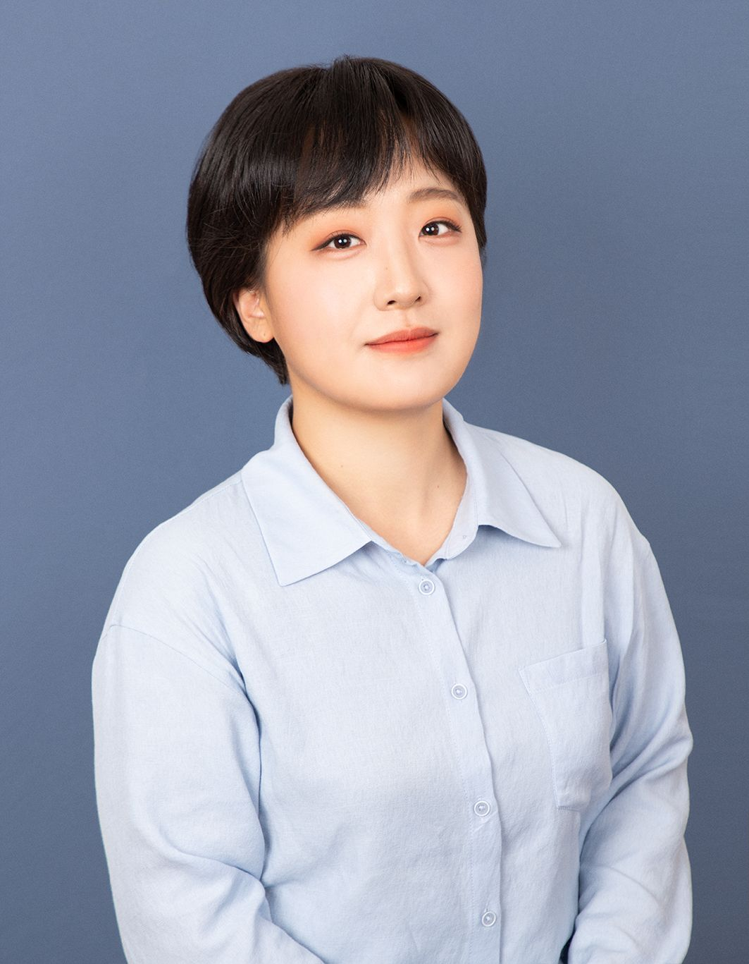
Lecturer Information
Hyemin Ahn (안 혜 민, 安 惠 旻)
Assistant Professor (2022.05 ~ Present)
AI & Human-Robot Interaction Laboratory, AIGS, UNIST.
PostDoc. Researcher (2020.04 ~ 2022.04)
Human-centered Assistive Robotics (HCR) Group, Technical University of Munich.
Institute of Robotics and Mechatronics, German Aerospace Center.
MS/Ph.D. Integrated Course (2014.03 ~ 2020.02)
Robot Learning Laboratory, Seoul National University.
Bachelor Course (2010.03 ~ 2014.02)
Department of Electrical Engineering, Seoul National University.
https://hyeminahn.oopy.io, https://sites.google.com/view/ahri-lab

Slide 3
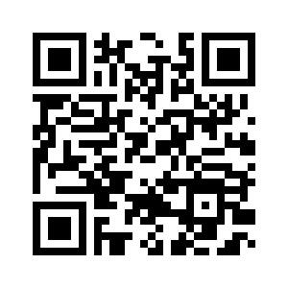
Quick Survey
https://forms.gle/mioZt3aBP7ZYRtsy8

Slide 4
Course Objective
We will learn how to “code” (Deep) Neural Networks.
If you do not know much about AI, don’t worry.
We will start from learning basic things.
If you do know much about AI…
This course might not be challenging for you.
Please bring a laptop or other device that can write a code in “Google Colab”

Slide 5
Syllabus
Date | Material
8/28 | Course Introduction
8/30 | No class
9/4 | Basics of Python
9/6 | Basics of Python / Data Manipulation
9/11 | Data Manipulation, Data Processing
9/13 | Linear Algebra, Calculus (slides only)
9/18 | Linear Algebra, Calculus, Automatic Differentiation (programming only)
9/20 | Probability and Distribution (slides only)
9/25 | Loss Function & Optimization (Slides only)
9/27 | Linear Regression & Classification (programming)
10/2 | Korean Thanksgiving day (no class)
10/4 | Multi-Layered Perceptron (slides)
10/9 | Hangul Nal (no class)
10/11 | Multi Layered Perceptron (programming) (Project 1 Release)
10/16 | Mid-term (no class)
10/18 | Mid-term (no class)
Mon, Wed
2:30-3:45 pm

Slide 6
Syllabus
Date | Material
10/23 | Convolutional Neural Network - 1
10/25 | Convolutional Neural Network - 2
10/30 | Convolutional Neural Network - 3
11/1 | Recurrent Neural Network - 1 (Project 1 Deadline)
11/6 | Recurrent Neural Network - 2
11/8 | Attention + Transformers - 1
11/13 | Attention + Transformers - 2
11/15 | Attention + Transformers - 3 (Project 2 Release) (Video Lecture)
11/20 | Computer Vision
11/22 | Natural Language Processing
11/27 | Reinforcement Learning
11/29 | Generative Models : GAN
12/4 | Generative Models : VAE
12/6 | Generative Models : Diffusion Model
12/11 + 12/13 | Final Exam (no class) (Project 2 Deadline will be set up flexibly)
Mon, Wed
2:30-3:45 pm

Slide 7
Grading System
Assignments: 100%
Index | Project 1 | Project 2
Topic | (Shallow) Models for Classification & Regression | (Deep) Models for Classification & Regression
Percentage | 40% | 60%

Slide 8
Office Hour & Communication
Starting from 6th of September.
Every Wednesday, 11:00-12:00
Visit my office (Building Nr. 106, 701-2) if you have any question related to the course.
Please send me an e-mail (hyemin.ahn@unist.ac.kr) or slack message before visiting.

Slide 9
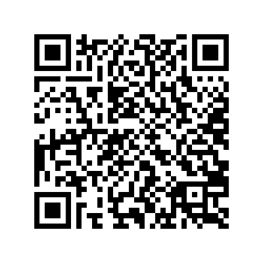
Office Hour & Communication
Join the slack channel below :)
aitoolkit2023unist.slack.com

Slide 10
Reference Materials
Dive Into Deep Learning.
http://www.d2l.ai/
Mathematics for Machine Learning.
https://mml-book.github.io/
Python Machine Learning Perfect Guide (파이썬 머신러닝 완벽 가이드), Chulmin Gwon.
For English speakers : https://www.oreilly.com/library/view/deep-learning-from/9781492041405/

Slide 11
Any Questions?

